Slide 1
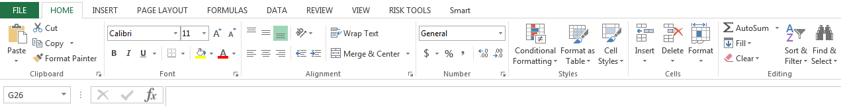
Overview of the Excel screen
Overview
Syntax
The Excel screen has a ribbon to allow for easy access to the key features of the program. Click through the ribbon or use the Alt key to toggle between different tabs and buttons in each tab
The ribbon is entirely customizable - you can rearrange the tools in the ribbon
The cell location and formula bar are located above the sheet. Multiple tabs can also be displayed while the program is open
Top ribbon (Home, Insert, Page Layout, Formulas, Data, Review, View)
Cell location
Formula bar
Uses and Applications
Tips and Tricks
The ribbon is the place to go to view key groupings of features
When you use the Alt key shortcut, all of the possible options become visible
You don’t need to use a mouse to use Excel. Everything can be done by using Alt and hotkeys
You can install third-party add-ins to Excel that create new tabs in the ribbon

Slide 2

Formula bar
Overview
Syntax
=((5+(2*4)-3)/2)^2
The names of cells begin with A1 in the top left. Columns are named by letters, and rows by numbers
The equals sign “=“ begins a formula, and formulas can include numbers and other cells
You can have multiple sheets and workbooks open while Excel is running, and you can reference cells from different sheets in a single workbook
Answer is 25
Uses and Applications
Tips and Tricks
Use formulas to make calculations in a cell based on a relationship with another cell or multiple cells
Formulas follow the PEMDAS order of operations:
Parentheses, Exponents, Multiplication and Division, and Addition and Subtraction
Commas and brackets are used to separate parts of a function

Slide 3
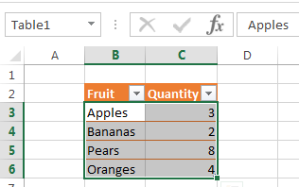
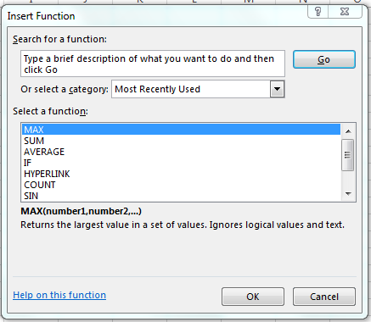

Formula logic
Overview
Syntax
Click on a formula in the formula bar to tab through a formula’s components. Excel provides hints on the logic of the formula
Clicking the fx button allows you to insert a formula step-by-step through the UI
Some fields in a formula are mandatory, while others are optional
FX button
=INDEX(array, row_num, [column_num])
Mandatory field
Optional field
Named range
Uses and Applications
Tips and Tricks
Each formula has unique logic that you must follow to make the formula calculate a result
If you are unsure which formula to use or how to construct it, use the “fx” button
The user interface will provide instructions on how to add the formula
Commas are used to separate logical parts of a formula
Function
Input Criteria
Array

Slide 4
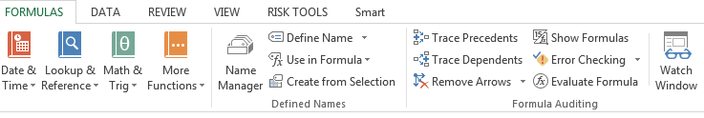
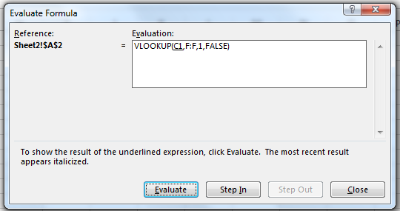
Editing formulas
Overview
Syntax
Double click on a formula or go to a cell and press F2 to view and edit the formula
If you are unsure where the contents of a cell are derived, you can go to that cell and then click Formulas > Trace Dependents or Trace Precedents
To examine an especially complex formula, you can click into the contents of a cell and then go to Formulas > Evaluate Formula. From there, you can see each component
Trace Dependents Trace Precedents
Evaluate Formula
Uses and Applications
Tips and Tricks
These are best used most often if you are examining another person’s work or working with complex datasets
Trace Dependents, Trace Precedents, and Evaluate Formula are helpful tools if someone else sends you a spreadsheet and you do not understand certain cells

Slide 5
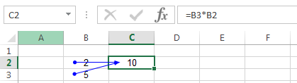
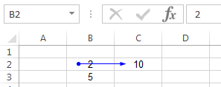
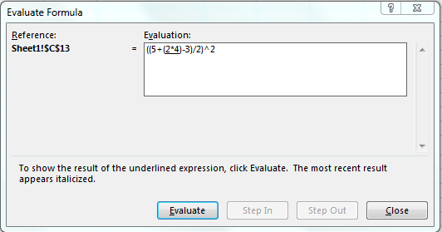
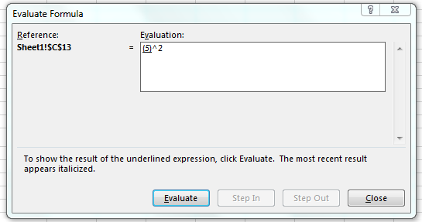
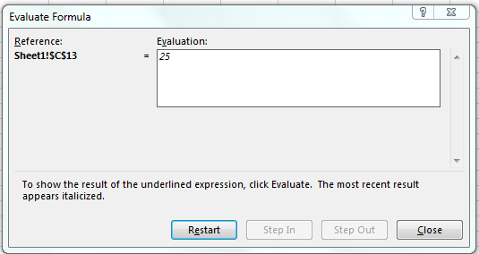
Editing formulas, continued
Trace Precedents
Trace Dependents
After clicking “Trace Precedents,” Excel shows which other cells are used in the formula to calculate the selected cell
After clicking “Trace Dependents,” Excel shows which other cells contain formulas that use the selected cell
Evaluate Formula
If you click “Evaluate Formula,” you can use the UI to trace each step of the formula evaluation process

